Slide 1

Job market analysis and Recommendation system
ASHA SANDEEP
NOIDA
DIGICHROME ACADEMY
Project-8
submission date:-10th jan,2025
To Nexthikes@info.

Slide 2
objectives
Objective
The project aims to provide a deep understanding of workforce trends and deliver a personalized job
recommendation system. By analyzing job market data, the platform will identify high-demand roles,
uncover salary patterns, highlight emerging job categories, and provide job seekers with tailored
opportunities that align with their preferences and market needs.

Slide 3
project statement
Challenges in the Job Market:
Job seekers struggle to find relevant opportunities.
Recruiters face difficulty identifying the right candidates.
Market Complexity:
Overwhelming amount of data from multiple job platforms.
Mismatches between job requirements and candidate skills.

Slide 4
solution
I got solution from google and geeks for geeks .
For Job Seekers: Focus on skills and qualifications related to the top keywords to increase employability.
For Recruiters: Align job descriptions with common keywords to attract suitable candidates effectively.
For Analysts: Use these insights to explore deeper trends, such as the correlation between keyword frequency and salary or job location.

Slide 5
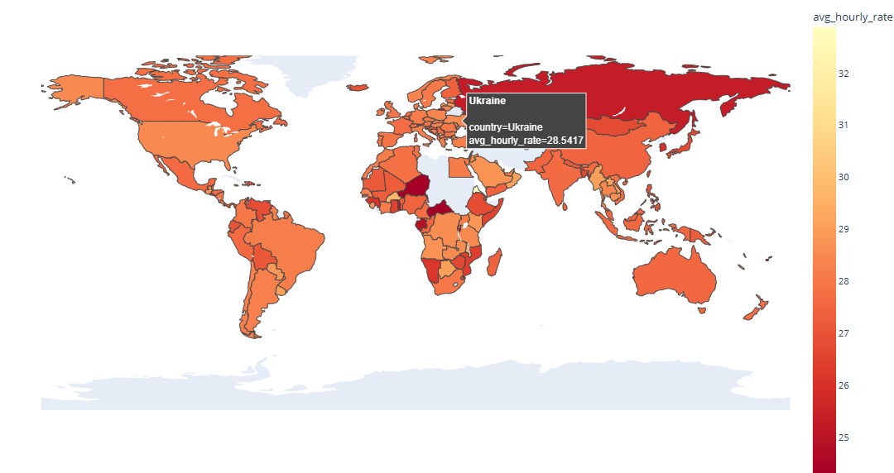
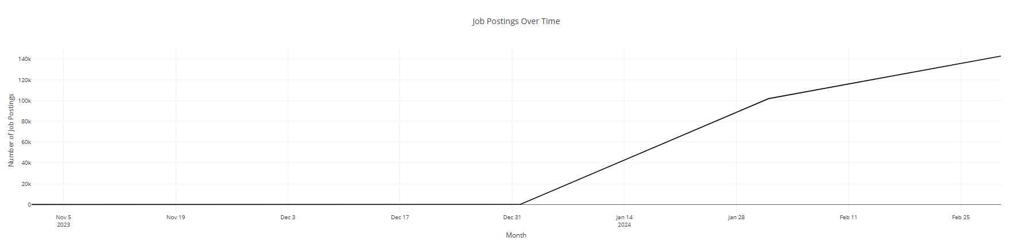
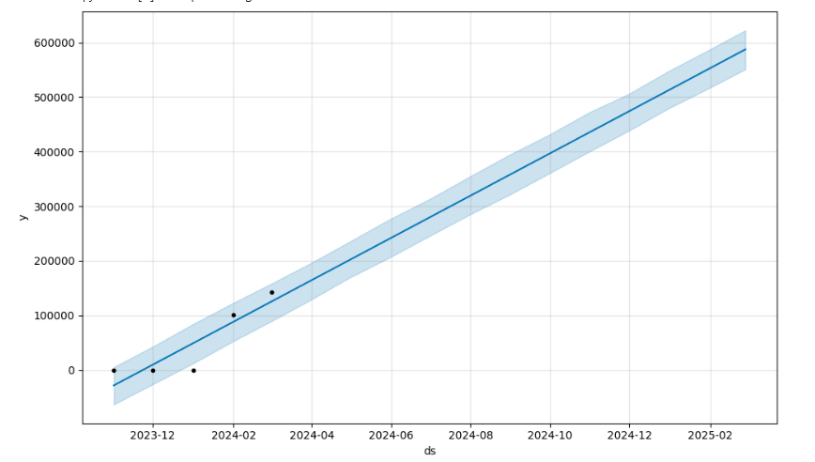
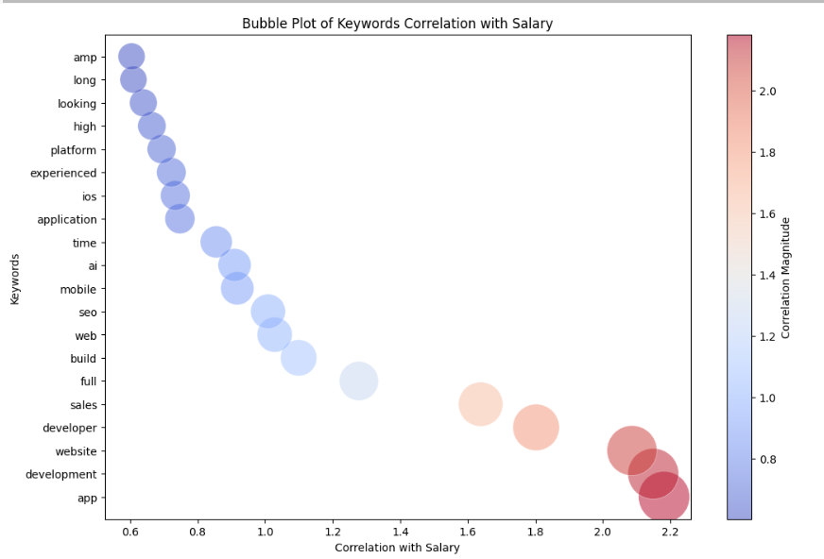
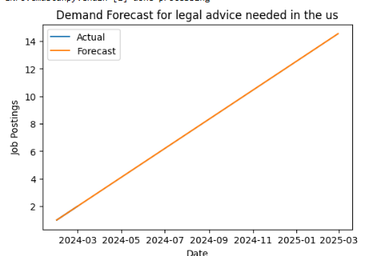
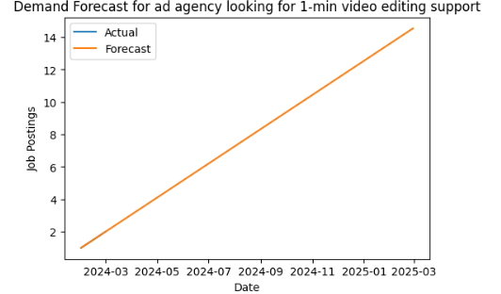
keyfeatures

Slide 6
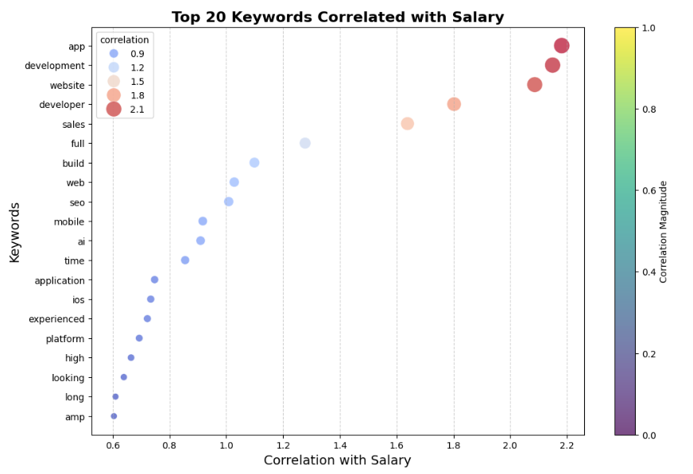
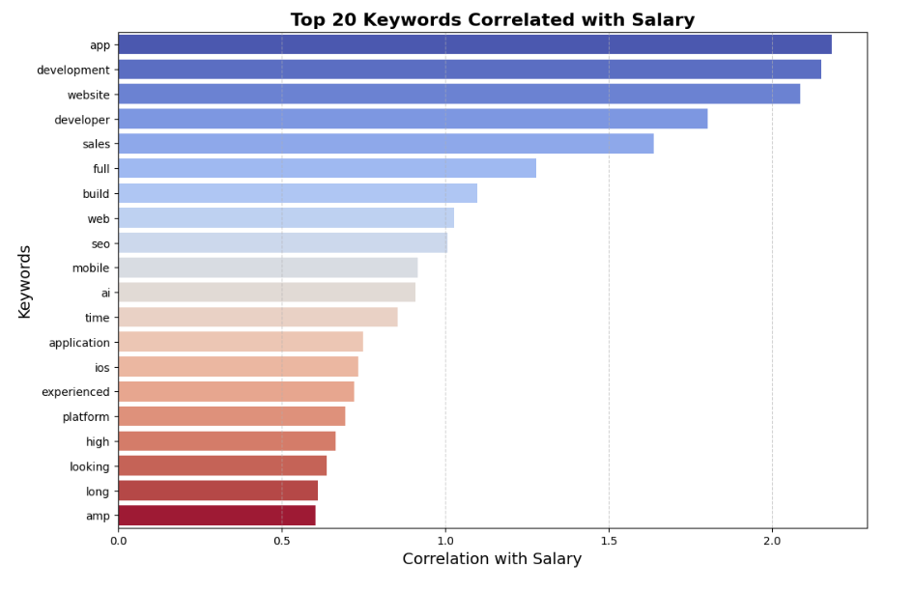
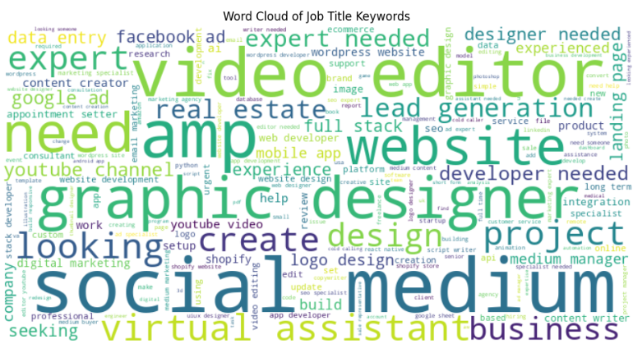
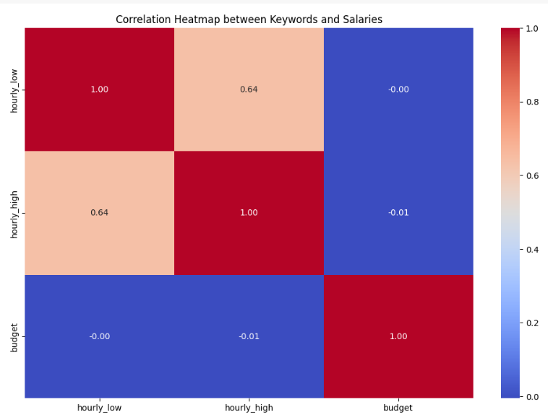
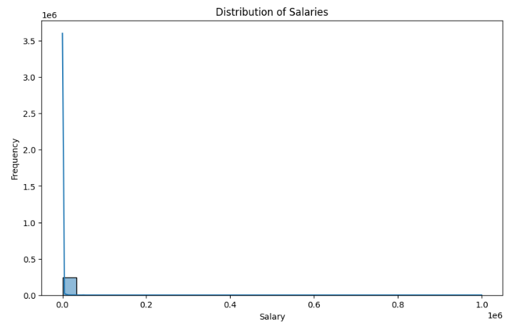
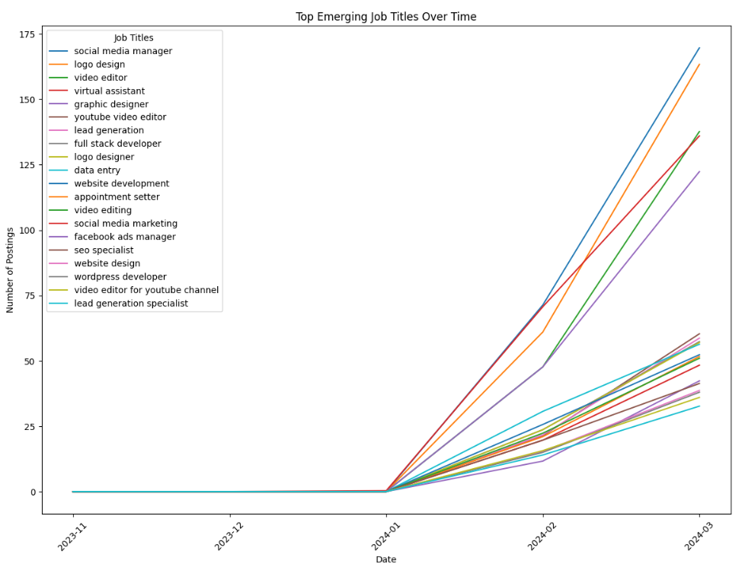
keyfeatures

Slide 7

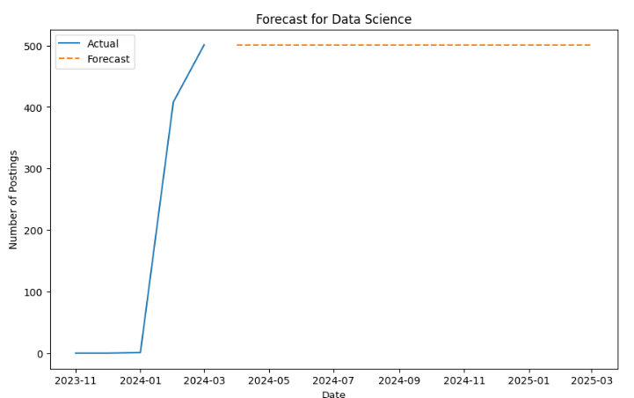
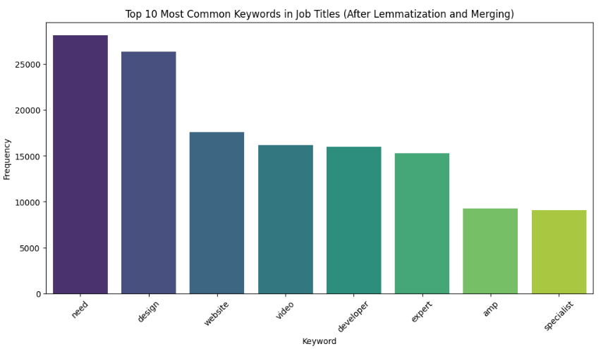
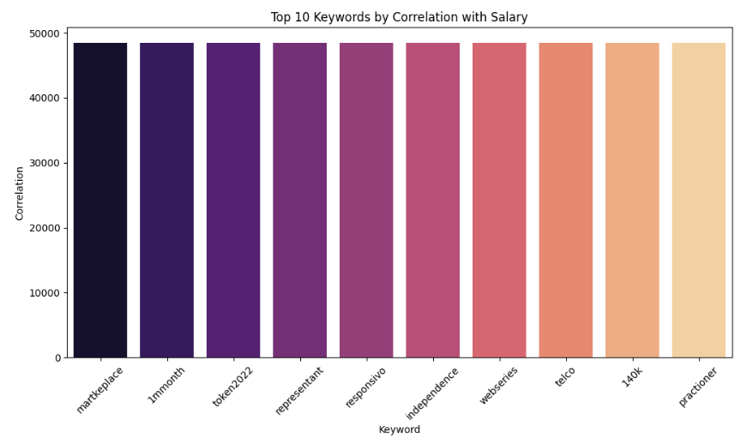
keyfeatures

Slide 8
methodology
Data Preprocessing:
Cleaning and standardizing data.
Removing duplicates and inconsistencies.
Exploratory Data Analysis (EDA):
Analyzing job trends, top industries, and skills demand.
Recommendation Algorithm:
Collaborative Filtering, Content-Based Filtering, or Hybrid Approach.
Matching skills and preferences with job listings.
Visualization:
Interactive dashboards for job market insights

Slide 9
Result and achievments
For Job Seekers:
Personalized job recommendations.
Insights into skills to acquire for better opportunities.
For Recruiters:
Access to a filtered pool of suitable candidates.
Improved hiring efficiency.
For Stakeholders:
Clear understanding of market trends.

Slide 10
challenges faced
challenges face in deployment and correlation .

Slide 11
conclusion
The Job Market Analysis and Recommendation System aims to empower job seekers with actionable insights and personalized job suggestions, facilitating better career decisions in an ever-changing job market.

Slide 12


